Slide 1
Activity 1: DIGITAL IMAGE FORMATION AND ENHANCEMENT
Genesis Vertudez – 202003099
App Physics 157 - Computational Analysis and Modeling in Physics
Submitted to Dr. Maricor Soriano; Mx. Rene Principe Jr.

Slide 2
OBJECTIVES
Mathematically create images
Save images as different file types
Enhance grayscale and color images
Use backprojection to manipulate the histogram of an image to a desired distribution

Slide 3
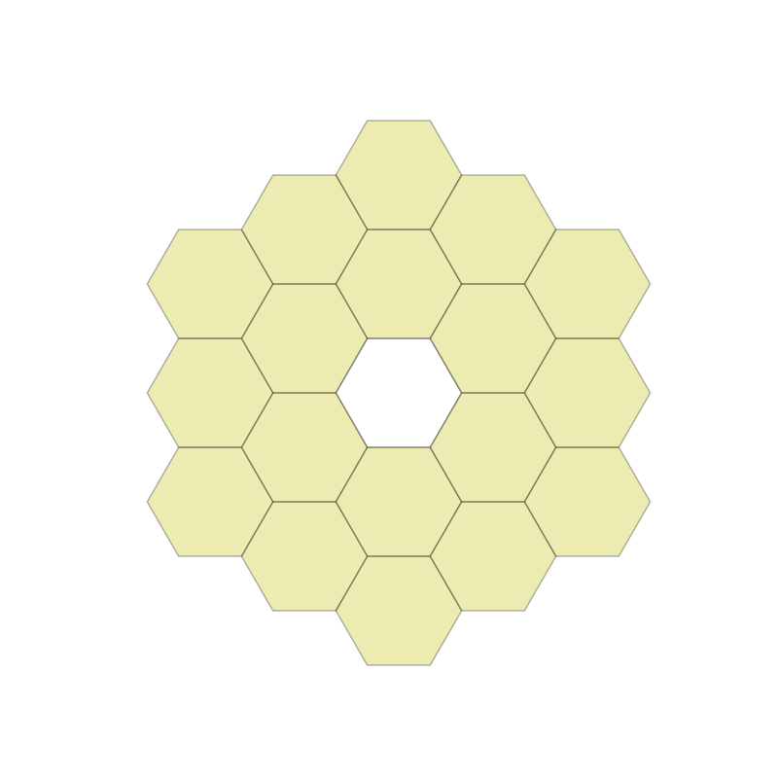




RESULTS & ANALYSIS
Codes and files: https://github.com/genvert/AP_157_FX-2_Vertudez/tree/main/Activity%201

Slide 4
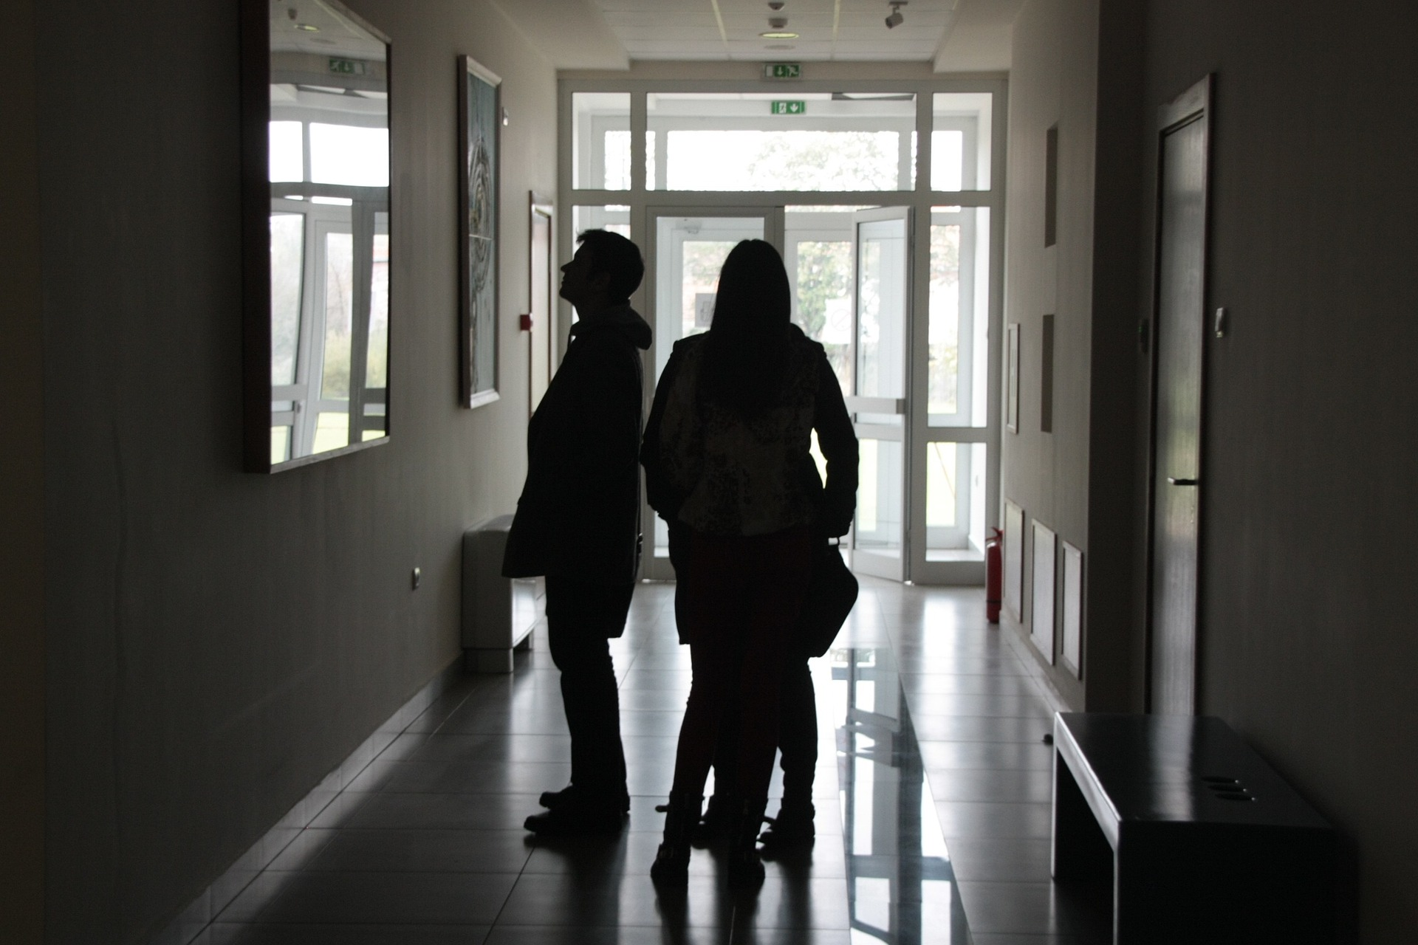
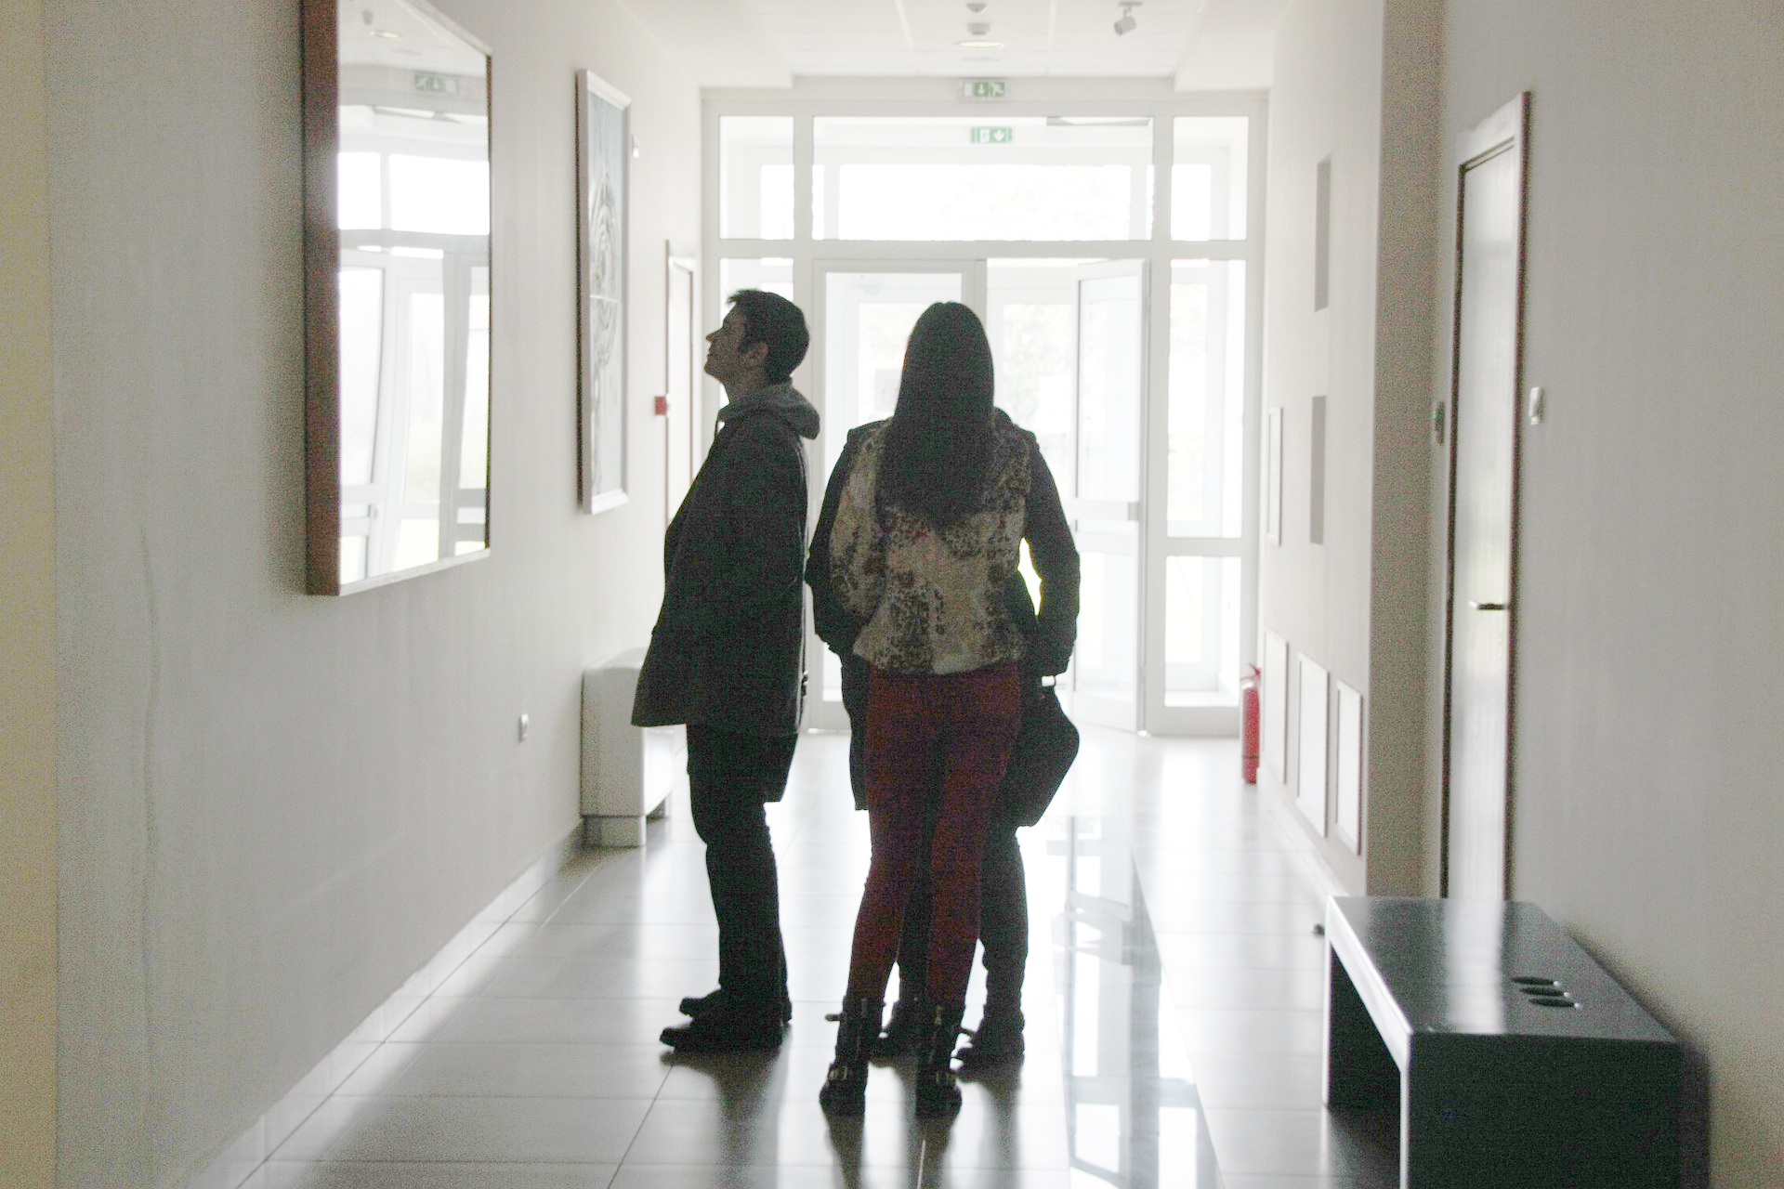
RESULTS & ANALYSIS
Codes and files: https://github.com/genvert/AP_157_FX-2_Vertudez/tree/main/Activity%201

Slide 5
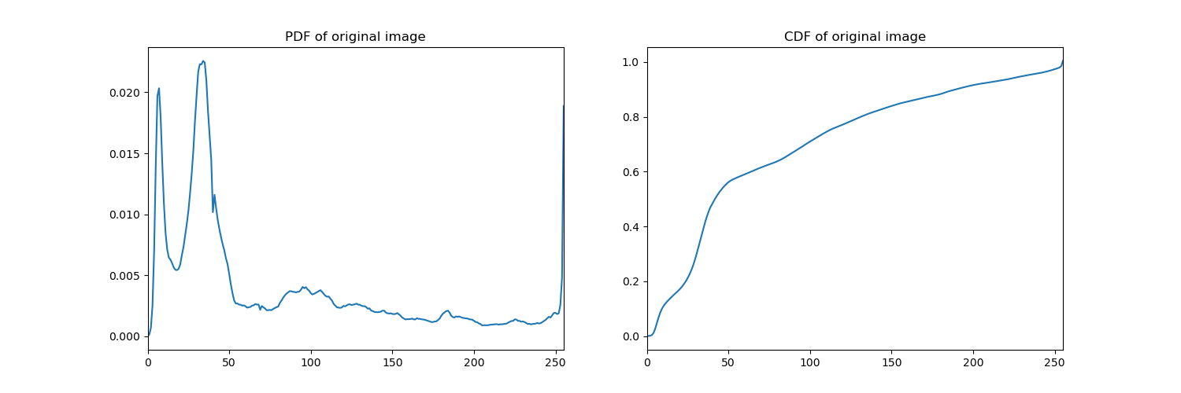
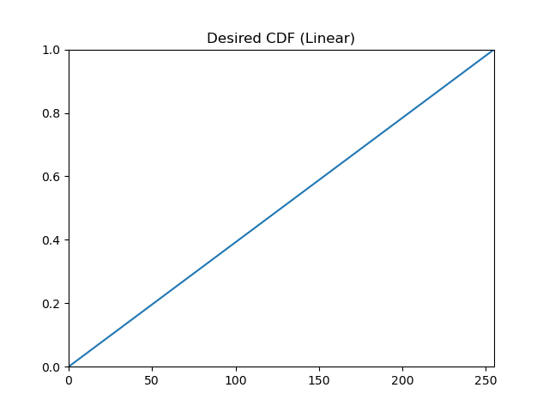
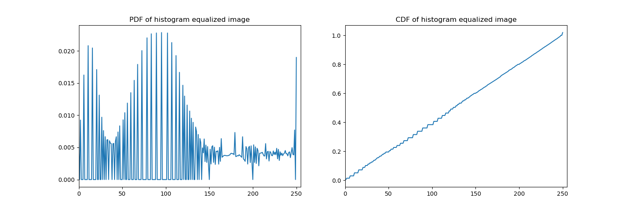
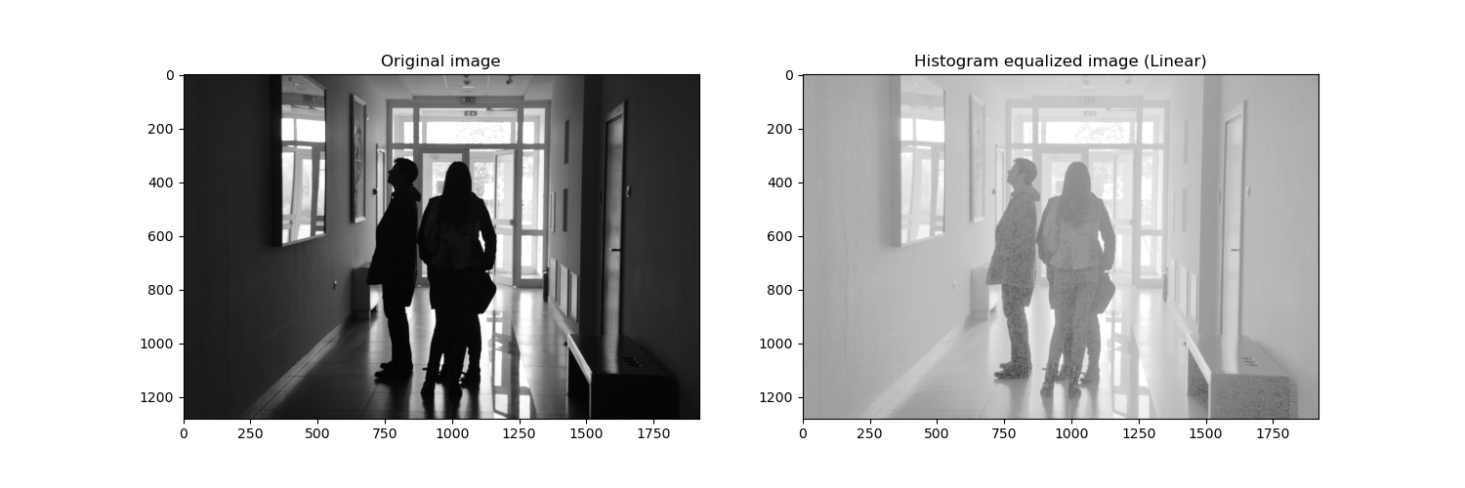
RESULTS & ANALYSIS
Codes and files: https://github.com/genvert/AP_157_FX-2_Vertudez/tree/main/Activity%201

Slide 6
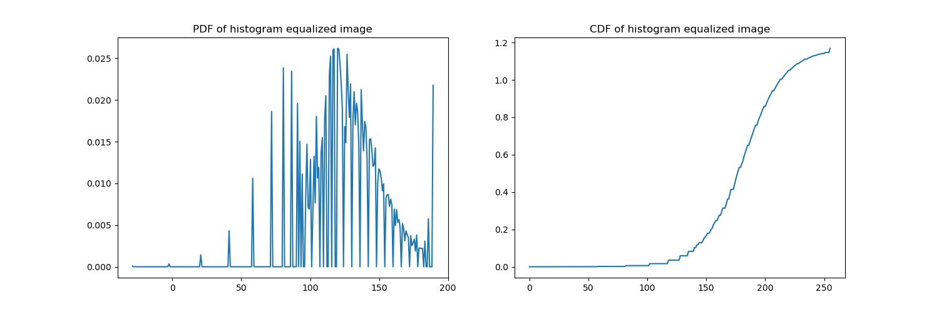

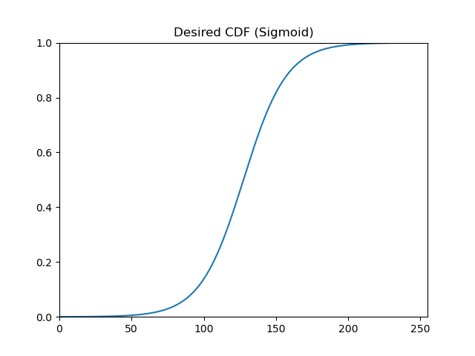
RESULTS & ANALYSIS
Codes and files: https://github.com/genvert/AP_157_FX-2_Vertudez/tree/main/Activity%201

Slide 7
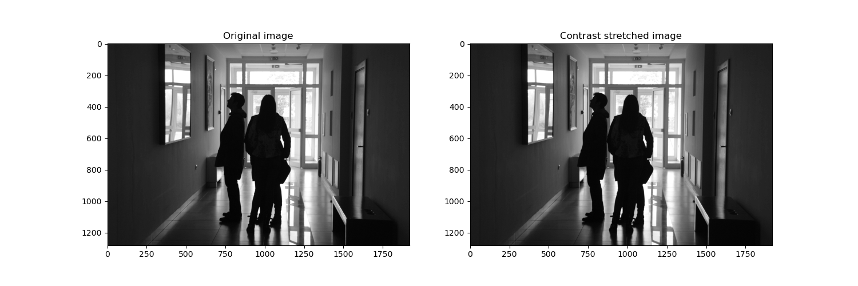
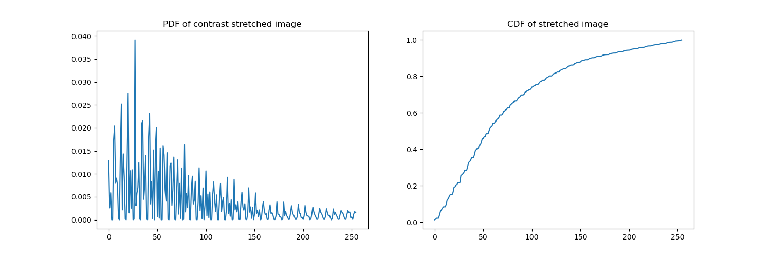
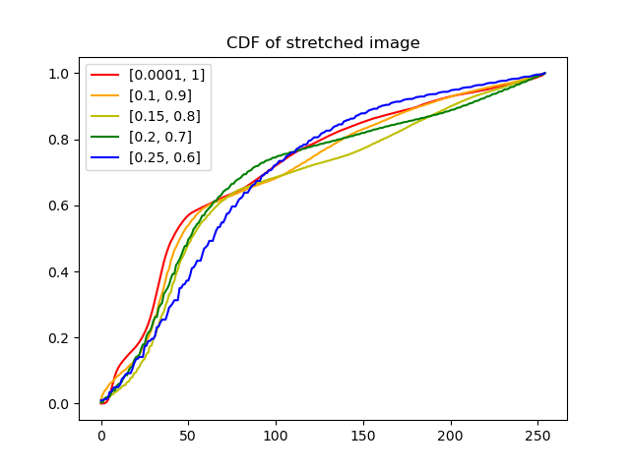
RESULTS & ANALYSIS
Codes and files: https://github.com/genvert/AP_157_FX-2_Vertudez/tree/main/Activity%201

Slide 8
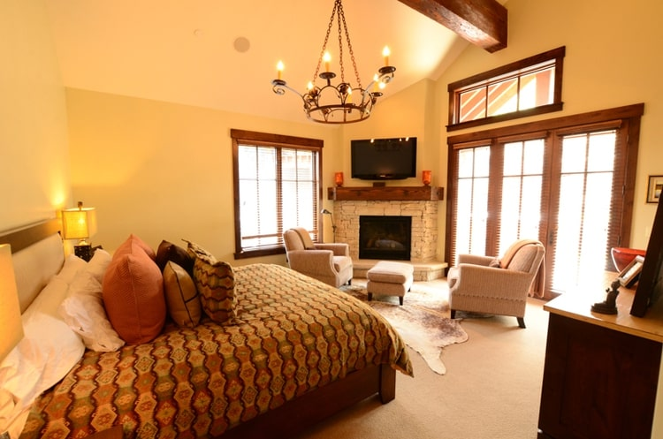
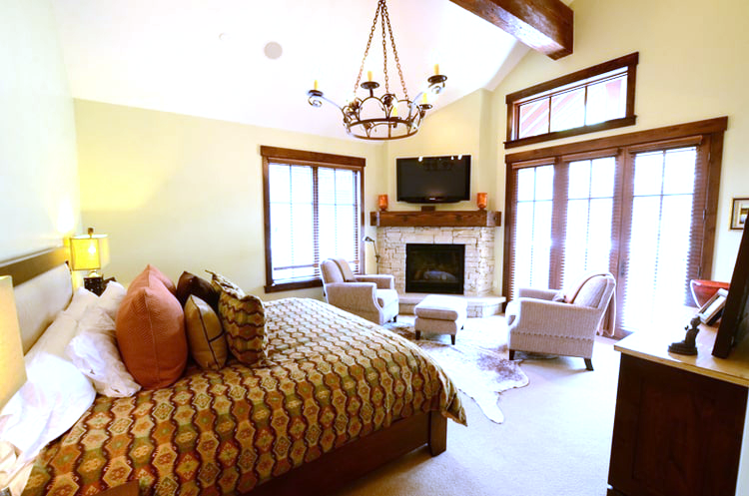
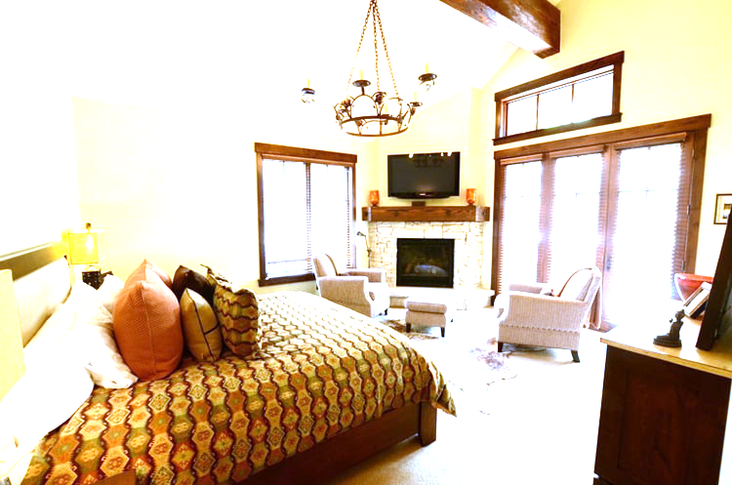
RESULTS & ANALYSIS
Codes and files: https://github.com/genvert/AP_157_FX-2_Vertudez/tree/main/Activity%201

Slide 9
REFLECTION
I had a hard time understanding how to generate the hexagons in Python.
I was not able to start and finish the activity on time.

Slide 10
SELF-GRADE
Technical correctness: 35/35
I am confident that I understood how to use ImageJ to extract feature from images, and have applied it.
Quality of presentation: 35/35
I have explained each step, and images are clear and concise.
Self-reflection: 30/30
Even though I was slacking in this subject for a while, I managed to get back on track. The topics are really fun and interesting. It helped me understand the ideas behind image tools such as smartphone cameras, Photoshop, etc.
Initiative: 10/10
I used an extra image for extraction.

